Slide 1

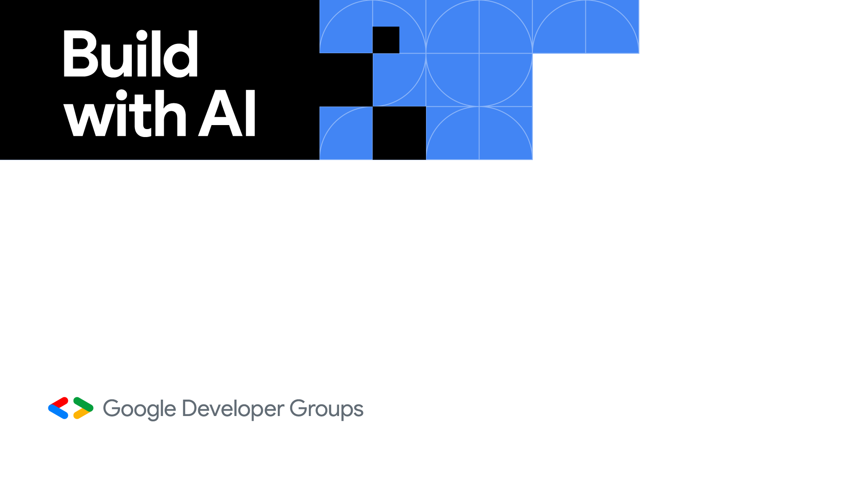



Venturing into the world of Generative AI with Gemini and Gemma
Vizag
Nitin Tiwari
Google Developer Expert – Machine Learning Software Engineer @ LTIMindtree

Slide 2
$whoami
Software Engineer at LTIMindtree
Google Developer Expert in Machine Learning
Technical speaker; talks across India and South East Asia
Contributor to Google Dev Library
Love writing blogs on AI/ML

Slide 3
Content
What is Gemini?
Architecture of Gemini
Hands-on: Gemini on Colab, Google AI Studio & Vertex AI
Gemma & PaliGemma
Hands-on: Zero-shot object detection with PaliGemma
Examples built with Gemini
Resources

Slide 4
Language models over the years
Established the foundation for future language models by representing words as vectors in a high-dimensional space.
Built upon the Transformer architecture, BERT was pre-trained on a massive dataset of text and code.
Trained on a massive dataset of text and code, for tasks like summarization, question answering, and translation.
Demonstrating impressive performance in reasoning, factual language understanding, and code generation.
Context length to 1 million tokens, further enhancing its ability to understand and respond to longer and more complex prompts.
Word2Vec
Transformers
BERT
XLNet
T5
LaMDA
PaLM
Gemini 1.0
Gemini 1.5
Gemma
2016
2017
2018
2019
2020
2021
2022
2023
2024
2024
Based on the Attention mechanism, allowing models to focus on specific parts of the input sequence.
This model addressed some limitations of BERT by introducing masked and permutation language modeling.
Focused on generating more engaging and informative dialogue for conversational AI applications.
Introduced the Mixture-of-Experts (MoE) architecture, allowing for improved efficiency and performance on complex tasks.
A family of light-weight SOTA open models built from the same research and technology used to create the Gemini models.
Based on the Attention mechanism, allowing models to focus on specific parts of the input sequence,

Slide 5
Gemini
Gemini is a family of the largest, multi-modal AI models developed by Google DeepMind.
Trained on a large dataset of text, code, images, videos, audio, etc., it can perform various complex tasks such as writing a summary of a big piece of text, detecting content in an image/video, writing codes for you, and much more.
Gemini is available in following variants – Gemini Ultra, Gemini Pro, Gemini Flash and Gemini Nano.
Gemini Ultra 1.0
The largest and most capable model for highly complex tasks. (available through Gemini Advanced subscription)
Gemini Pro 1.5
The best-performing model; up to 2 million token context window (available in Vertex AI, Google AI Studio)
Gemini Flash 1.5
Lighter-weight model, fast and efficient; up to 1 million token context window
(available in public preview on AI Studio)
Gemini Nano
The most efficient model for on-device GenAI apps.
(limited preview; supports Pixel 8 Pro and Samsung Galaxy S24)

Slide 6
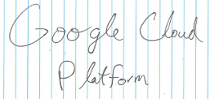
Architecture of Gemini
Suggest me some best places to visit in India. (text)
Varanasi: Pilgrimage site, river Ganges
Ladakh: Breathtaking Himalayan landscapes
Rishikesh: Yoga capital of the world
def model:
# complete the code (code)
Encoder
Mixture of Experts (MoE)
Decoder
def model:
model = tf.keras.Sequential([
tf.keras.layers.Flatten(…)
tf.keras.layers.Dense(…)
Encoder: Takes input formats like text, code, images, or audio and converts them into a common internal representation that the decoder can understand.
Decoder: Based on the encoded information and the specific task at hand, the decoder generates outputs in different modalities, such as text, code, or translated languages.
Mixture of Experts: This component employs a network of smaller, specialized models ("experts") instead of a single, monolithic model. The input is routed to the most relevant expert based on its characteristics for improved efficiency and performance.
The image you sent me shows a piece of lined paper with the words "Google Cloud Platform" written on it in black ink. There are also several faint horizontal lines in the background, which suggests the paper is likely from a notebook.
What’s present in this image? (image)

Slide 7

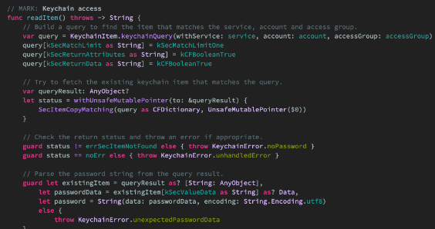
Benchmarks of Gemini 1.5 Pro, Flash
Enhancement to Gemini 1.0, with a larger token context window (1,28,000) and can go up to 1 million tokens (Flash 1.5) and 2 million tokens (Pro 1.5).
How much data is 1 million tokens?
Needle in a Haystack evaluation: 99% times Gemini Pro 1.5 found a small piece of text containing a particular fact or statement purposely placed within a long block of text of about 1 million tokens.
Videos up to 1 hour
Audio up to 11 hours
~ 30,000 lines of code
Learn more: https://blog.google/technology/ai/google-gemini-next-generation-model-february-2024/
Media Source: Google Images

Slide 8
Hands-on with Gemini: Colab
Step 1: Go to Google AI Studio and generate an API key.
Step 2: Clone the repository: https://github.com/NSTiwari/Build-with-AI-Vizag-2024
Step 3: Upload the Gemini_on_Colab.ipynb notebook file on Google Colab.
Step 4: Execute the cells in the notebook by following the instructions.

Slide 9
Hands-on with Gemini 1.5 Pro/Flash: Google AI Studio
Step 1: Go to Google AI Studio and generate an API key.
Step 2: Choose the Gemini 1.5 Pro/Flash model.
Step 3: Try prompts with multi-modal data such as images, videos, texts, PDFs, etc.

Slide 10
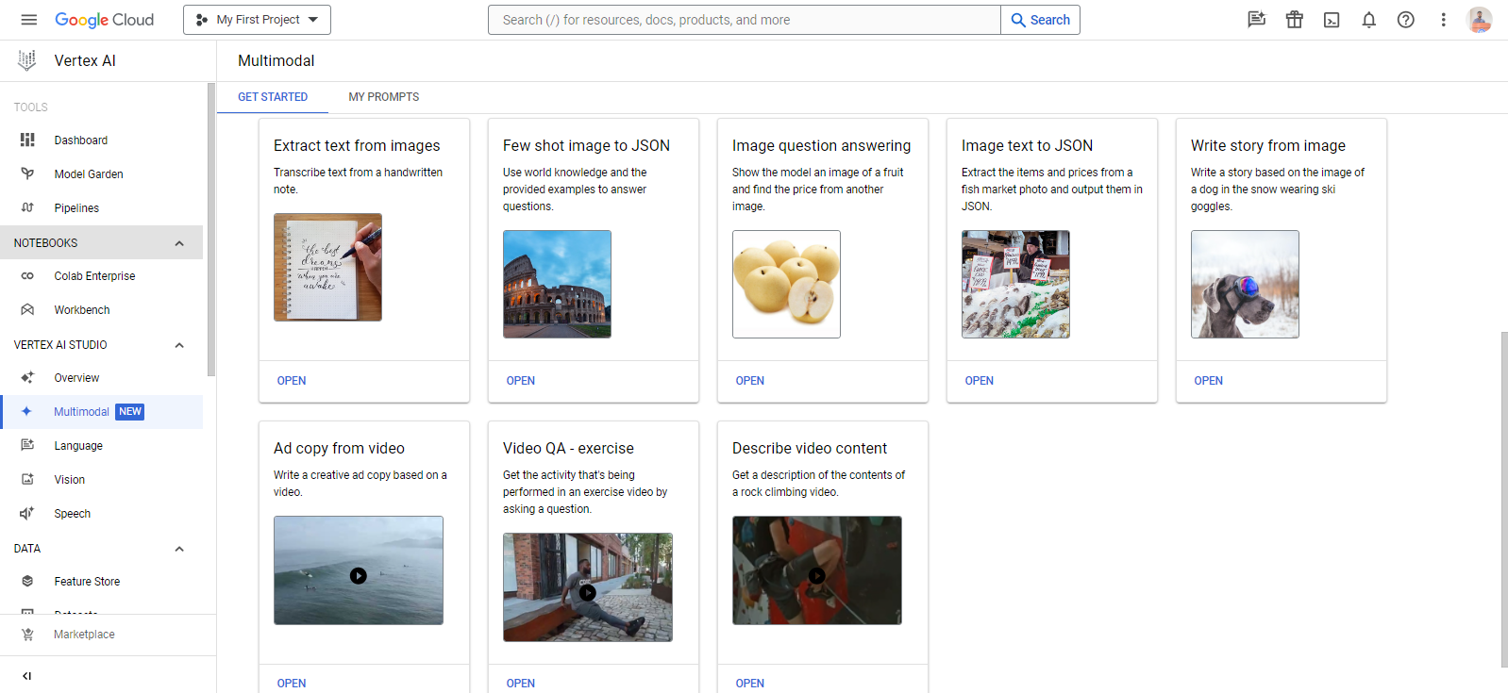
Hands-on with Gemini: Vertex AI on Google Cloud
Step 1: On the Google Cloud Platform, open the Vertex AI Studio and choose the Multimodal option.
Step 2: Experiment with different examples.

Slide 11
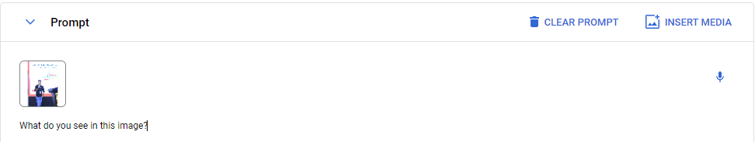
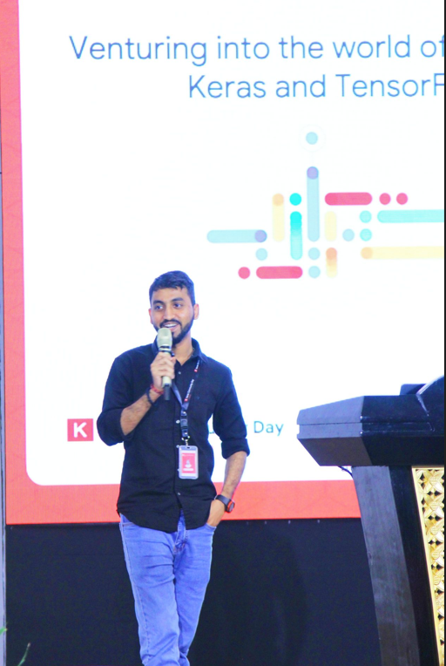
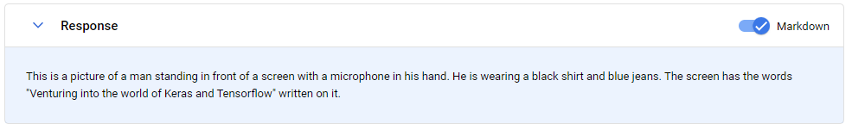
Hands-on with Gemini: Vertex AI on Google Cloud
Example: Gemini Pro Vision

Slide 12

Activity
Step 1: Scan the following QR code.
Step 2: Give a text prompt and try it yourself.
Step 3: Take a screenshot of the results.
Step 4: Share it on Twitter (X) with the hashtags #BuildWithAI #GenerativeAI and tag @NSTiwari21 @GDGVizag
E.g. A cool lion with sunglasses driving a roofless car in space.

Slide 13
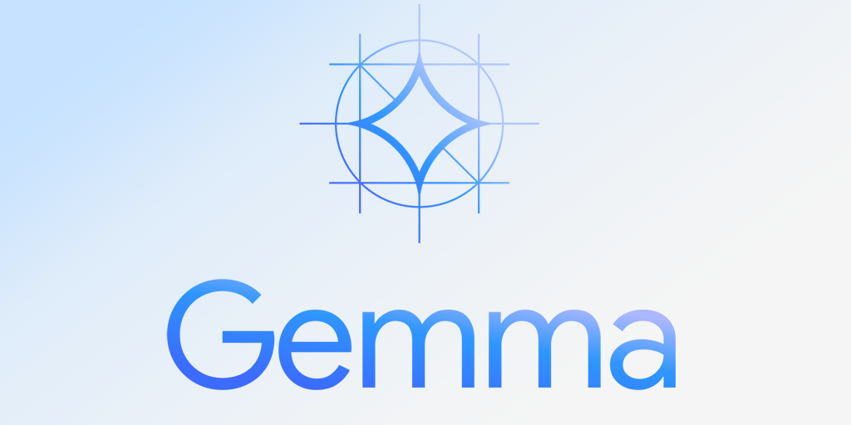
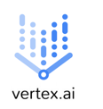

Gemma
Gemma is a family of lightweight, state-of-the-art open models built from research and technology used to create Google Gemini models.
They are text-to-text, decoder-only large language models, available in English, with open weights, pre-trained variants, and instruction-tuned variants.
Gemma is available in two variants – Gemma 2B and Gemma 7B on Vertex AI and Hugging Face.

Slide 14
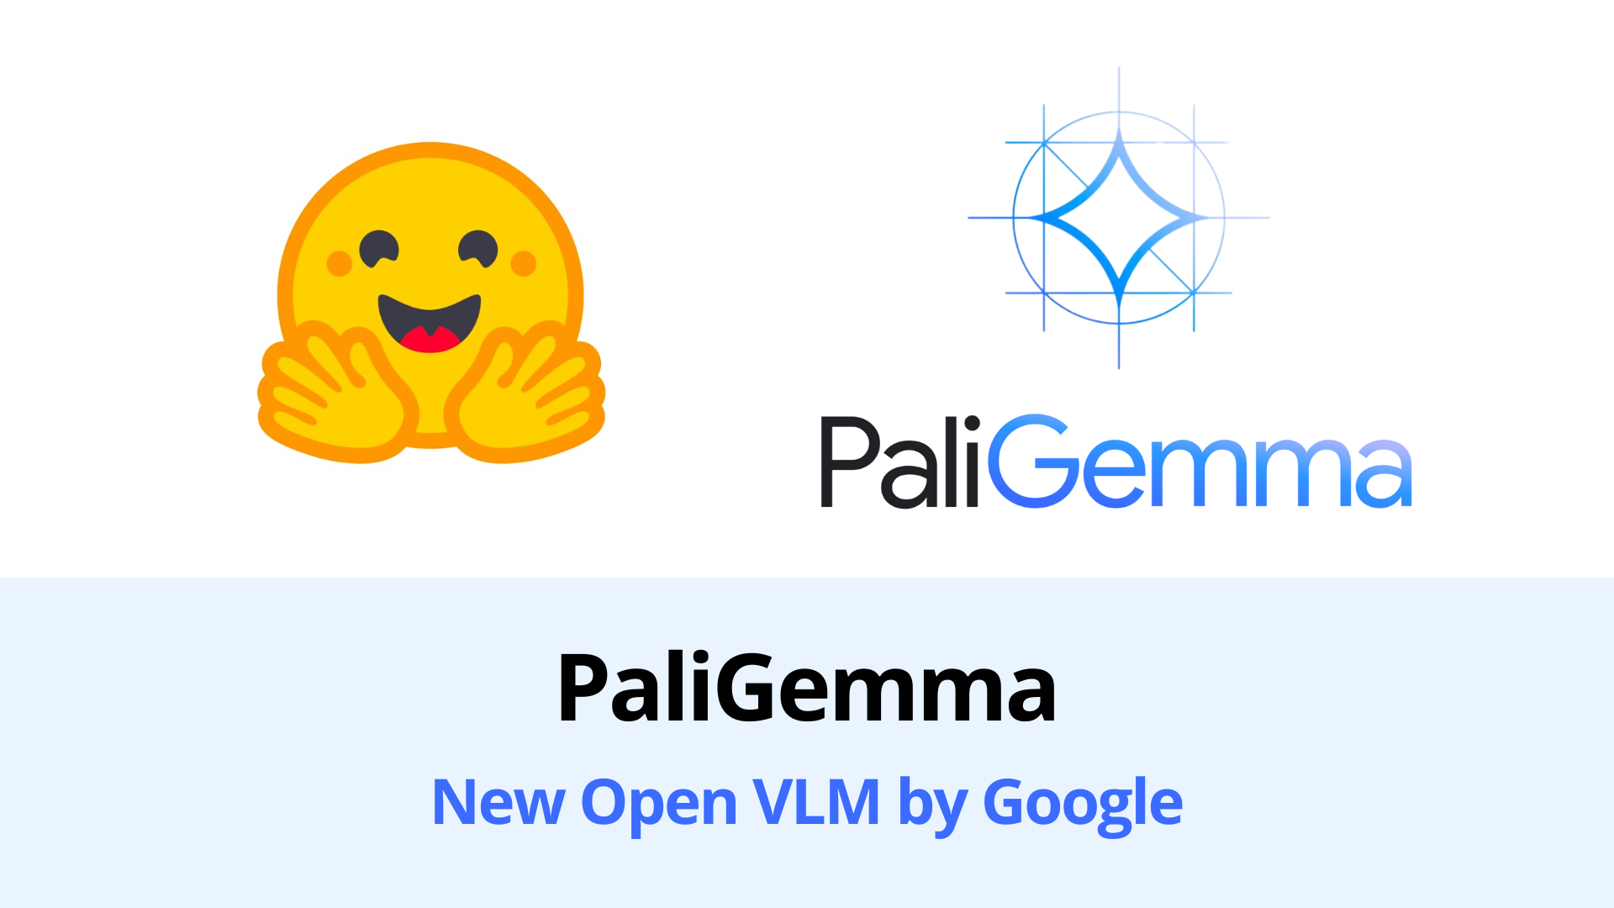
PaliGemma
PaliGemma is a light-weight open Vision Language Model based on the SigLIP vision model for vision capabilities and Gemma as the language model.
It can take input images and text as input and can answer questions about images, image captioning, object detection, and more.

Slide 15

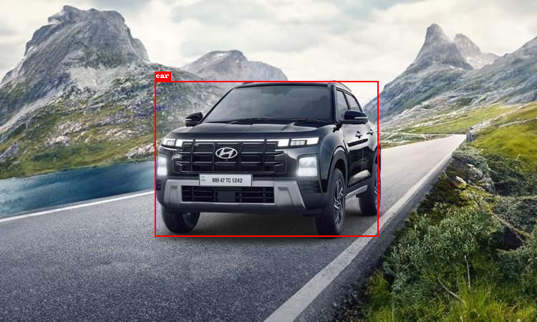
Hands-on: Zero-shot Object Detection with PaliGemma
Upload the Zero_Shot_Object_Detection_using_PaliGemma.ipynb notebook on Google Colab and run the cells by following the instructions.
Prompt: Detect car
Output

Slide 16
Examples built with Gemini & Gemma

Slide 17
💊 PharmaScan : Extract medicine details using Gemini
PharmaScan is an Android application that leverages the Gemini Pro Vision model to identify medicines and provide their details such as usage, dosage, diagnosis, etc. on the go.
Check out on GitHub:
https://github.com/NSTiwari/Medicine-Scan-with-Gemini
Try it on Hugging Face 🤗:
https://huggingface.co/spaces/Aashi/Medicine-Prescription-with-Gemini
Watch the complete demo on YouTube:
https://www.youtube.com/watch?v=Q06ABLwFGTQ

Slide 18
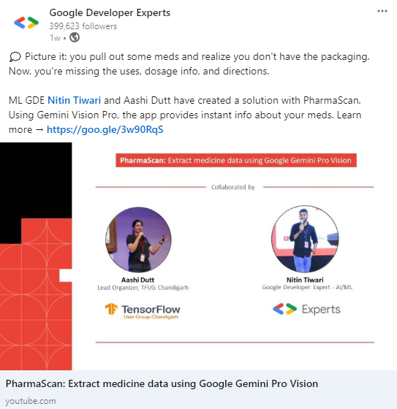
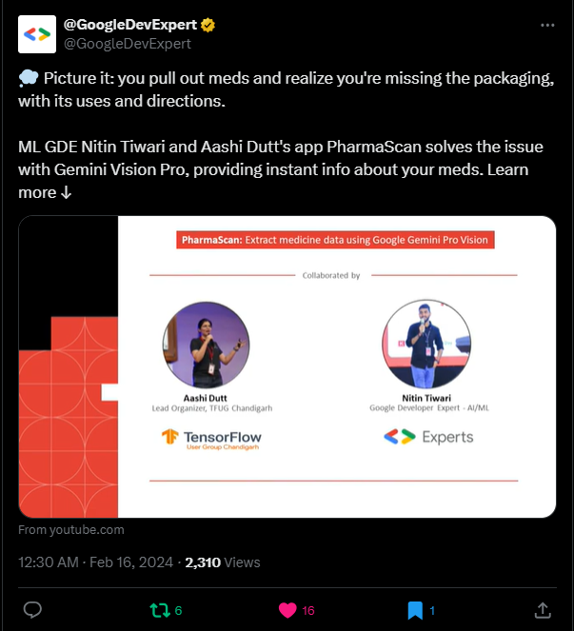
*The project was featured on the official handle of Google Developer Expert*

Slide 19
🧑‍🌾 FarmScan : Farmer’s Digital Assistance built with Gemini
FarmScan is an implementation of the Google Pro Vision model API on Android to recognize the freshness of fruits/vegetables, their approximate market value, shelf life, and a lot more insights to help farms plan the cultivation/selling of crops better.
Check out on GitHub:
https://github.com/NSTiwari/FarmScan-using-Gemini
Try it on Hugging Face 🤗:
https://huggingface.co/spaces/Aashi/FarmScan

Slide 20
🧪 SciGemma : An end-to-end pipeline to deploy Gemma on Android

Slide 21
🧪 SciGemma : An end-to-end pipeline to deploy Gemma on Android
SciGemma is an Android app that leverages the Gemma model's on-device capabilities.
Developed by fine-tuning the Gemma 2B-it model on a custom dataset of Science textbooks, it offers students the convenience of revising their course materials anytime, anywhere, and offline.
Check out on GitHub:
https://github.com/NSTiwari/Gemma-on-Android
Medium Blogs
Part 1: Create custom dataset for Q&A
Part 2: Fine-tune Gemma 2b-it
Part 3: Deploy Gemma on Android
Watch the complete demo on YouTube:
https://www.youtube.com/watch?v=T_HDsVHTrwg

Slide 22
Resources

Slide 23
Resources
Google AI Studio: https://aistudio.google.com
Get started with examples on https://ai.google.dev/examples
Google AI SDK for JavaScript: https://github.com/google/generative-ai-js
Getting started with Gemini Nano (on-device): https://ai.google.dev/tutorials/android_aicore?hl=en
Gemini API: Quickstart with Python: https://ai.google.dev/tutorials/python_quickstart?hl=en
Android SDK for Gemini API: https://ai.google.dev/tutorials/android_quickstart?hl=en
Gemini on Google Cloud Platform: https://github.com/GoogleCloudPlatform/generative-ai/

Slide 24

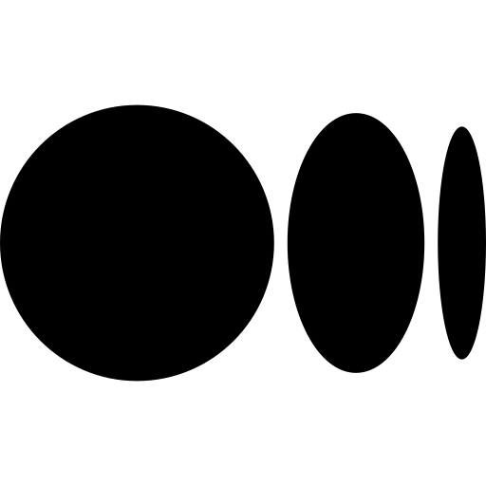


Thank You.
medium.com/@tiwarinitin1999
twitter.com/@NSTiwari21
github.com/NSTiwari

